Slide 1
Robot Path
Studio training

Slide 2
RobotPath: [Loop NameArray] m
Prompt for input from user
The fixed NameArray variables is declared
System
Initialize the count to start at zero
System
Loop through the array to find words that start with letters A-J
System
Are there any words that meet the condition?
Yes
No
Give the final count
Try again
System
System
Output the Count on Message Box
END
System
Initialize the count to start at zero
System

Slide 3
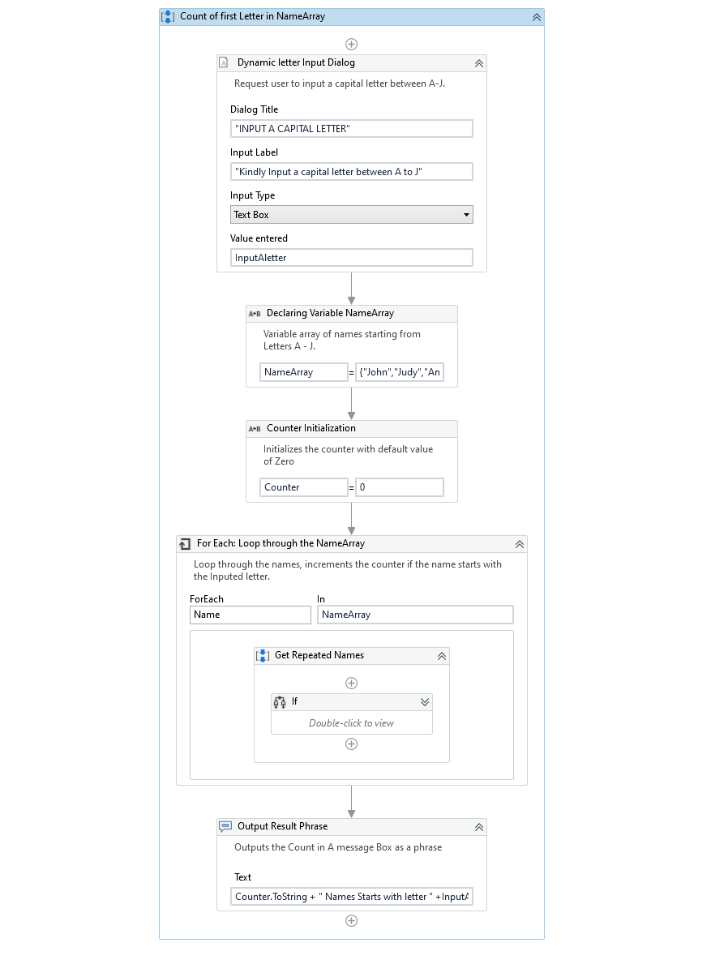
RobotPath: [Loop NameArray] m
Initialize the count to start at zero
System

